Slide 1



Seemeen Wookey
(201703165)

Slide 2


Current recommender systems used by anime streaming services struggle with recommending diverse content.
A recommendation system with increased recommendation diversity would increase content consumption, loyalty and product satisfaction among users.
This would be of benefit to anime streaming services like Crunchyroll, Funimation, Netflix, or Hulu.

Slide 3
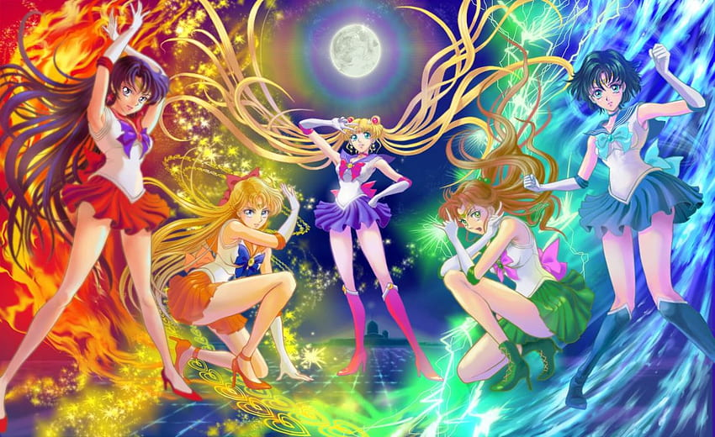

Recommend 10 anime titles based on what other people enjoy
Recommend 10 anime titles based on the features of other similar anime

Slide 4




1. Business Understanding
2. Data Understanding
3. Data Preparation
4. Modelling
5. Evaluation
6. Deployment
Develop recommendation system with increased recommendation diversity and improved exposure for lesser-known titles
User preferences
Content popularity
User-anime interactions
Data Cleaning
Data Preprocessing
Exploratory Data Analysis
Content-based filtering
Collaborative filtering
Mean Squared Error and Mean Absolute Error
Recommendations
CRISP-DM
Notes:
This project will follow the CRISP-DM (Cross-Industry Standard Process for Data Mining) methodology to develop a hybrid recommendation system addressing over-specialization and the long-tail problem in anime recommendation systems. CRISP-DM is a comprehensive and systematic approach to data mining projects consisting of six key phases.
1.Business Understanding
Current recommender systems used by anime streaming services struggle with recommending diverse content due to over-specialization and neglect of lesser-known titles (long-tail problem).
A recommendation system with increased recommendation diversity and improved exposure for lesser-known titles would increase content consumption, loyalty and product satisfaction among users. This would be of benefit to anime streaming services like Crunchyroll, Funimation, Netflix, or Hulu.
2.Data Understanding
There are three datasets, each in CSV file format viz. ‘anime info’, ‘user details’ and ‘user ratings’. We will analyze each dataset to understand user preferences, content popularity, and user-anime interactions. We'll explore rating distributions, popular genres, user segmentation based on watch habits, and user plan-to-watch lists. By combining insights from all datasets, we can create a comprehensive picture of user behavior and content to inform the development of the recommendation system.
3.Data Preparation
During this phase we will perform data cleaning and preprocessing as well as exploratory data analysis. We will address any data quality issues that might impact the model's performance. This involves handling missing values in any dataset, either through imputation techniques or strategic removal. We'll also identify and correct inconsistencies or errors in data points.
Next, we'll explore feature engineering for textual data like anime synopses. This might involve extracting keywords or topics that represent additional features relevant to user preferences. Numerical features might also be normalized for better model performance.
For data integration, we will combine information from the anime data (features like genre, studio) with user data (ratings, watch history) into a unified format suitable for modeling. This might involve creating a user-anime matrix, where rows represent users and columns represent anime titles. The values within this matrix could indicate user interactions or potential connections based on user preferences and anime features.
4.Modeling
To create the recommendation system we will use a hybrid approach combining three techniques.
First, Content-Based Filtering recommends anime similar to what a user has enjoyed before. We'll adapt collaborative filtering algorithms like matrix factorization to find anime with similar features (genre, director, studio) to the user's favorites.
Second, Collaborative Filtering leverages user behavior. By analyzing the user-anime interaction data (ratings, watch history), it recommends anime enjoyed by users with similar tastes. Techniques like matrix factorization can identify underlying factors in user preferences and recommend anime associated with those factors for similar users.
Finally, Knowledge Graph Embedding captures relationships between anime and related entities (genres, studios) within a knowledge graph. Techniques like TransE or ComplEx translate these entities and their connections into a format the model understands. This allows the model to recommend anime linked to a user's favorites through these relationships, even if they fall outside the user's usual genres.
To get the best recommendations, we'll combine suggestions from each technique. We can assign weights based on their effectiveness (weighted averaging) or train them independently and combine their predictions (ensemble methods).
By using all three techniques, we aim to create a system that caters to user preferences for specific content, leverages the wisdom of similar users, and explores beyond immediate viewing history, ultimately addressing both over-specialization and the long-tail problem.
5.Evaluation
Suitable Metrics for Recommendation Systems include:
Mean Squared Error and Mean Absolute Error: these measure the difference between predicted ratings and actual ratings, indicating how well the model predicts user preferences.
Normalized Discounted Cumulative Gain: This metric considers both the relevance and ranking of recommendations. Higher NDCG signifies that the system prioritizes highly relevant items.
Diversity Metrics: These metrics (like Genre Entropy) measure how varied the recommendations are, ensuring the system doesn't suggest repetitive content from the same genre.
6.Deployment
A dashboard would help integrate the insights found from the model.

Slide 5

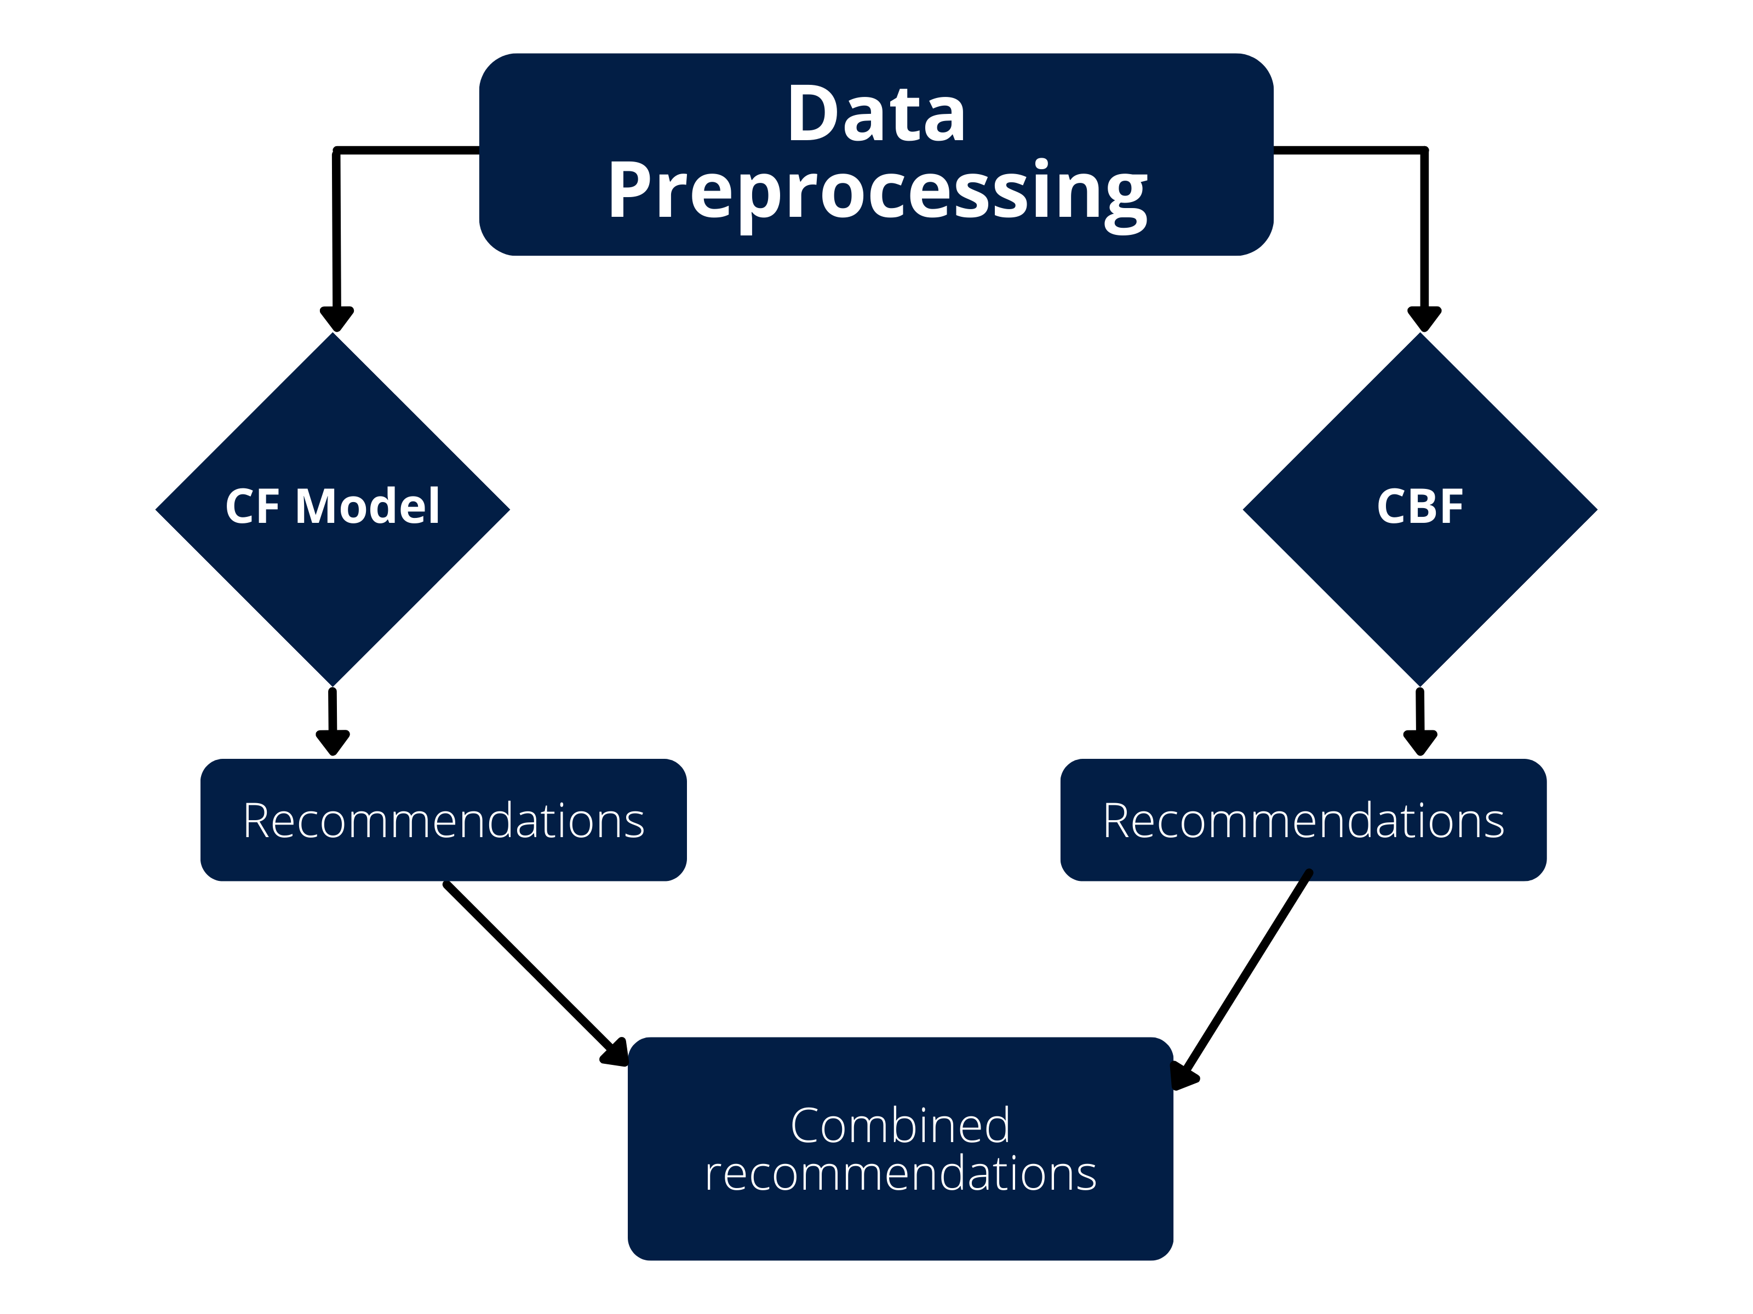
Process Flow

Slide 6

Final Model Data
Rating dataframe
Attribute | Data type | description | count
User_id | String | ID generated by MyAnimeList for its users at random | 24573682
Anime_id | String | ID from MyAnimeList website that uniquely identi_es each anime | 24573682
Rating | Integer | Rating assigned to an anime by a particular user | 24573682
Anime dataframe
Synopsis dataframe
Attribute | Data type | description | count
Name | String | Full name of the anime | 12309
Genre | String | Comma separated values identifying the genre/genres that each anime belongs to | 12309
Type | String | Series or movie etc | 12309
Rating | String | Parental guidance rating | 12309
Score | Integer | average score of the anime given from all users in MyAnimelist database | 12309
Popularity | Float | position based in the the number of users who have added the anime to their list. | 12309
Attribute | Data type | description | count
MAL_ID | String | ID from MyAnimeList website that uniquely identifies each anime | 16214
Name | String | Full name of the anime | 16214
Genres | String | Comma separated values identifying the genre/genres that each anime belongs to | 16214
Synopsis | String | Text in the form of string providing the synopsis of the anime | 16206

Slide 7



Derived Features:
Latent Factors for Users
Latent Factors for Anime
Item-Based Similarity Matrix
Anime Weight Similarity
Predicted Ratings
Features
Collaborative Filtering
Content-based Filtering
Method
Raw Features:
User-Anime Interactions
User ID
Anime ID
User Ratings
Derived Features:
TF-IDF for Genres
TF-IDF for Type
TF-IDF for Rating
Combined Score and Popularity Rank Metric
Weighted Feature Multiplication
Cosine Similarity
Raw Features:
Genres
Type
Rating
Score
Popularity Rank
Notes:
Collaborative Filtering Model
Raw Features:
User-Anime Interactions: The ratings that users have provided for specific anime titles (user-item matrix).
User ID: A unique identifier for each user.
Anime ID: A unique identifier for each anime title.
User Ratings: The ratings that users give to anime titles.
Derived Features:
Latent Factors for Users: Hidden features representing users’ preferences, learned during model training.
Latent Factors for Anime: Hidden features representing the anime titles' characteristics, learned during model training.
Item-Based Similarity Matrix: A matrix derived from comparing anime titles based on their latent factors.
Anime Weight Similarity: A measure of how similar two anime titles are based on user ratings and their latent factors.
Predicted Ratings: The estimated rating a user would give to an anime, based on their latent factors and the anime’s latent factors.
Content-Based Method
Raw Features:
Genres: Categories like Action, Comedy, Drama, etc.
Type: Format of the anime (TV, Movie, OVA, etc.).
Rating: Age rating of the anime (e.g., PG, R).
Score: User rating on a scale (e.g., 7.5/10).
Popularity Rank: Ranking based on the anime’s popularity among users.
Derived Features:
TF-IDF for Genres: Represents the importance of each genre in the anime.
TF-IDF for Type: Quantifies the importance of the anime format.
TF-IDF for Rating: Captures the importance of the age rating.
Combined Score and Popularity Rank Metric: Scaled and averaged to represent the overall popularity and quality of the anime.
Weighted Feature Multiplication: Final weighted multiplication of all TF-IDF features to prioritize key characteristics (like genres or score).
Cosine Similarity: Measures the similarity between two anime titles based on their TF-IDF vectors.

Slide 8

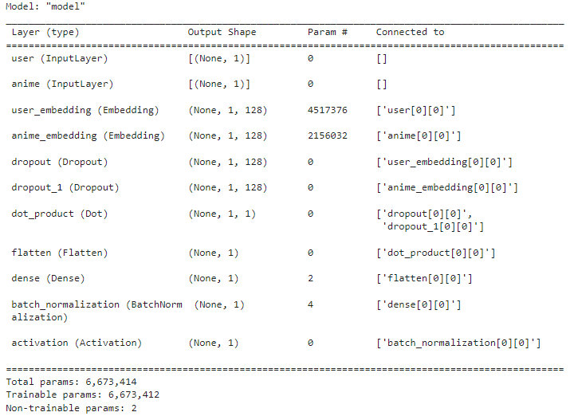
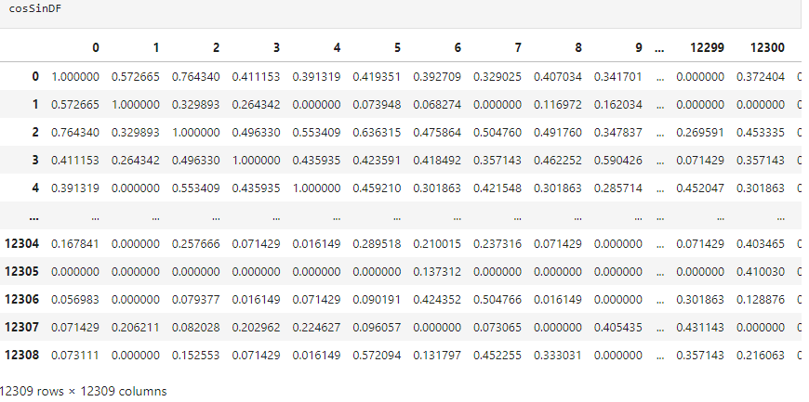
Algorithm and Model Details
Collaborative Filtering
Content-Based strategy
involves creating a recommendation system based on the content features of anime titles. We focus on several columns, such as Genres, Type, Rating, Score, and Popularity Rank, to build our system.
This architecture is designed for collaborative filtering in recommendation systems, where user-item interactions are predicted based on learned embeddings.
Notes:
Model Architecture:
The model uses two embedding layers, one for users and one for animes. These layers map categorical user and anime IDs to dense numerical vectors representing their latent features.
A dot product layer calculates the similarity between user and anime embeddings.
A single dense layer with sigmoid activation predicts the rating a user would give to an anime.
Model Parameters:
Embedding size: This is the dimensionality of the latent feature vectors used by the embedding layers. The code uses an embedding size of 128.
Learning rate: The code uses a learning rate scheduler that starts low, ramps up for a few epochs, and then decays to prevent overfitting.
Optimizer: The model uses the Adam optimizer with the learning rate scheduler.
Loss function: The model uses binary cross-entropy loss as it predicts ratings between 0 and 1 (scaled from the original range).
Metrics: The code monitors Mean Absolute Error (MAE) and Mean Squared Error (MSE) during training.
The Content-Based strategy involves creating a recommendation system based on the content features of anime titles. We focus on several columns, such as Genres, Type, Rating, Score, and Popularity Rank, to build our system. The TF-IDF (Term Frequency-Inverse Document Frequency) calculation in the Content-Based strategy works as follows:
TF (Term Frequency): Measures how often a feature (like a genre) appears in an anime relative to other features.
IDF (Inverse Document Frequency): Reduces the weight of common features (like popular genres) and gives higher weight to rare features.
TF-IDF: Combines TF and IDF to determine the importance of each feature in describing an anime.
Separate TF-IDF Tables: Calculated for genres, type, and rating.
Weighting: Assigns different importance (weights) to genres, type, and rating.
Concatenation: Merges the separate TF-IDF tables into one.
Score and Popularity Rank: Combines these into a single metric for popularity and quality.
Weighted Multiplication: Applies the score/rank to adjust the TF-IDF values.
Cosine Similarity: Measures how similar two anime titles are based on their TF-IDF vectors.
Recommendation: Finds and returns anime titles similar to the user's input title based on cosine similarity.

Slide 9

Model Performance
Metric | Training | Validation
Loss | 0.5919 | 0.5877
Mean Absolute Error (MAE) | 0.1315 | 0.1204
Mean Squared Error (MSE) | 0.0261 | 0.0235
Learning Rate (LR) | 0.000052261 | -
Notes:
This table shows that both training and validation metrics are quite close, which indicates that the model is performing well with minimal overfitting
The model has shown good performance on both the training and validation datasets, as indicated by the similar values for training and validation loss, MAE, and MSE. The difference between training and validation metrics is small, meaning the model generalizes well to new data, and there is no major overfitting or underfitting.
Validation Loss < Training Loss: Indicates the model generalizes well to unseen data and is not overfitting.
Low MAE and MSE: Shows the model's predictions are quite accurate, with minimal errors.
Small Learning Rate: Suggests the model is in the later stages of learning, fine-tuning its weights with small adjustments.

Slide 10

Results
 | name | similarity | genre
10 | Dragon Ball Z | 0.885399 | Action, Adventure, Comedy, Fantasy, Martial Arts, Shounen, Super Power
9 | Rurouni Kenshin | 0.787129 | Action, Adventure, Comedy, Historical, Romance, Samurai, Shounen
8 | One Piece Film Z | 0.768603 | Action, Adventure, Comedy, Drama, Fantasy, Shounen
7 | Hunter x Hunter | 0.767178 | Action, Adventure, Super Power, Fantasy, Shounen
6 | Yu Yu Hakusho:Ghost Files | 0.766122 | Action, Comedy, Demons, Supernatural, Martial Arts, Shounen
5 | Reborn! | 0.753528 | Action, Comedy, Shounen, Super Power
4 | One Piece Film Strong World | 0.751829 | Action, Adventure, Comedy, Drama, Fantasy, Shounen
3 | Hunter x Hunter: Greed Island Final | 0.739457 | Action, Adventure, Super Power, Fantasy, Shounen
2 | Hajime No Ippo:The Fighting! | 0.737633 | Comedy, Sports, Drama, Shounen
1 | Hunter x Hunter: Greed Island | 0.737105 | Action, Adventure, Super Power, Fantasy, Shounen
 | name | Cosine similarity | genre
10 | Dragon Ball Z | 0.983883 | Action Adventure Comedy Fantasy Martial-Art
9 | Dragon Ball Super | 0.983883 | Action Adventure Comedy Super-Power Martial-Ar...
8 | Dragon Ball Kai (2014) | 0.983883 | Action Adventure Comedy Fantasy Martial-Arts S...
7 | Dragon Ball Kai | 0.983883 | Action Adventure Comedy Super-Power Martial-A
6 | Naruto: Shippuuden | 0.961626 | Action Adventure Comedy Super-Power Martial-Ar.
5 | Naruto | 0.961626 | Action Adventure Comedy Super-Power Martial-Ar
4 | Flame of Recca | 0.948297 | Action Adventure Martial-Arts Shounen Super-Power
3 | Boruto:Naruto Next Generations | 0.948297 | Action Adventure Super-Power Martial-Arts Shounen
2 | Shadow Skill: Eigi | 0.930216 | Adventure Fantasy Magic Martial-Arts Super-Pow
1 | Wolverine | 0.893521 | Action Martial-Arts Super-Power

Slide 11




Model API
Method use cases
Notes:
Model API Insights
Integration with Front-End: The model API can be deployed as a web service that integrates with anime streaming or listing platforms. This allows real-time recommendations for users based on their viewing history or preferred genres.
Cold-Start Problem Solution: Content-based recommendations can help alleviate the cold-start problem, where there is insufficient user data, by recommending anime based purely on content similarity.

Slide 12

References

Slide 13



